Slide 1
Truth Table Reverse Engineering
By Anhadjot

Slide 2

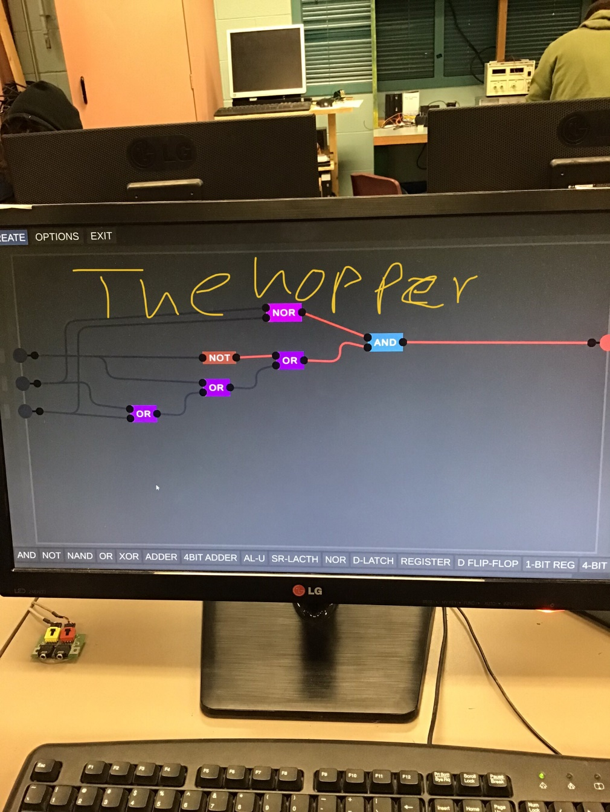
The hopper

Slide 3
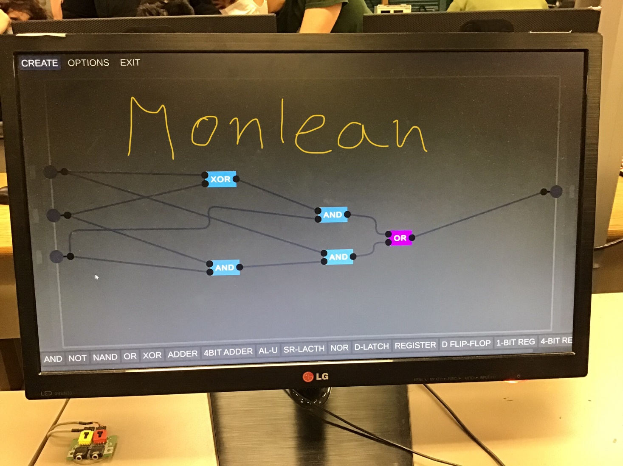
The Monleon

Slide 4
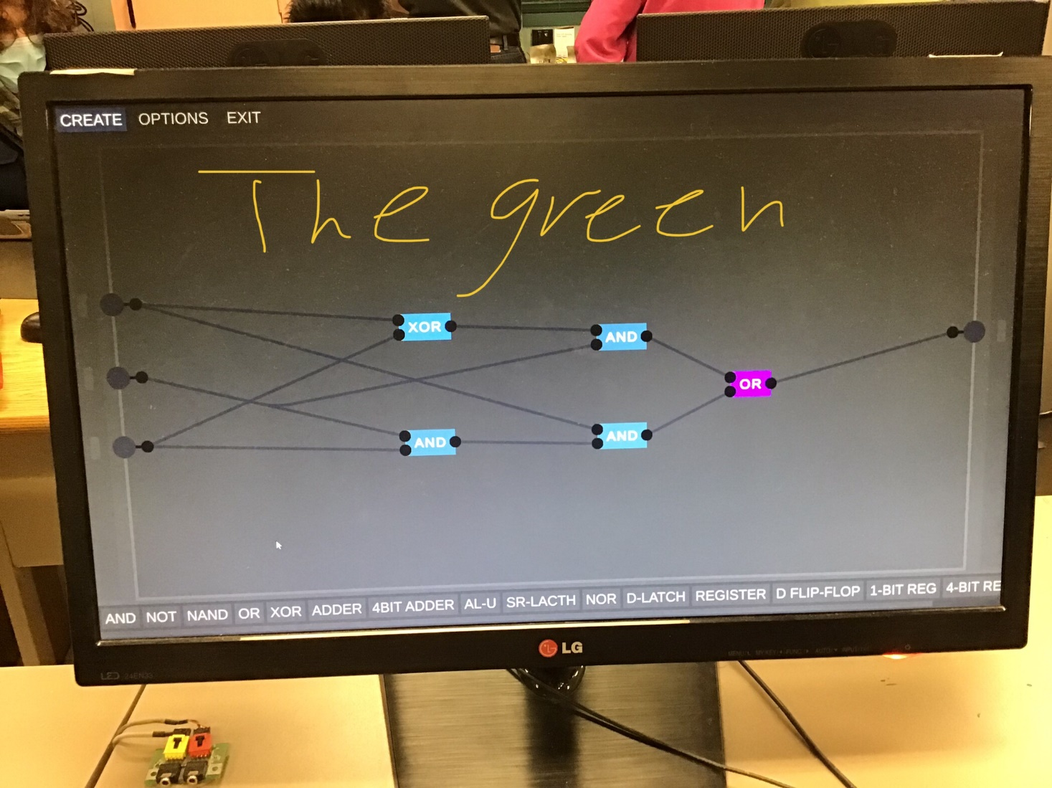
The Green

Slide 5
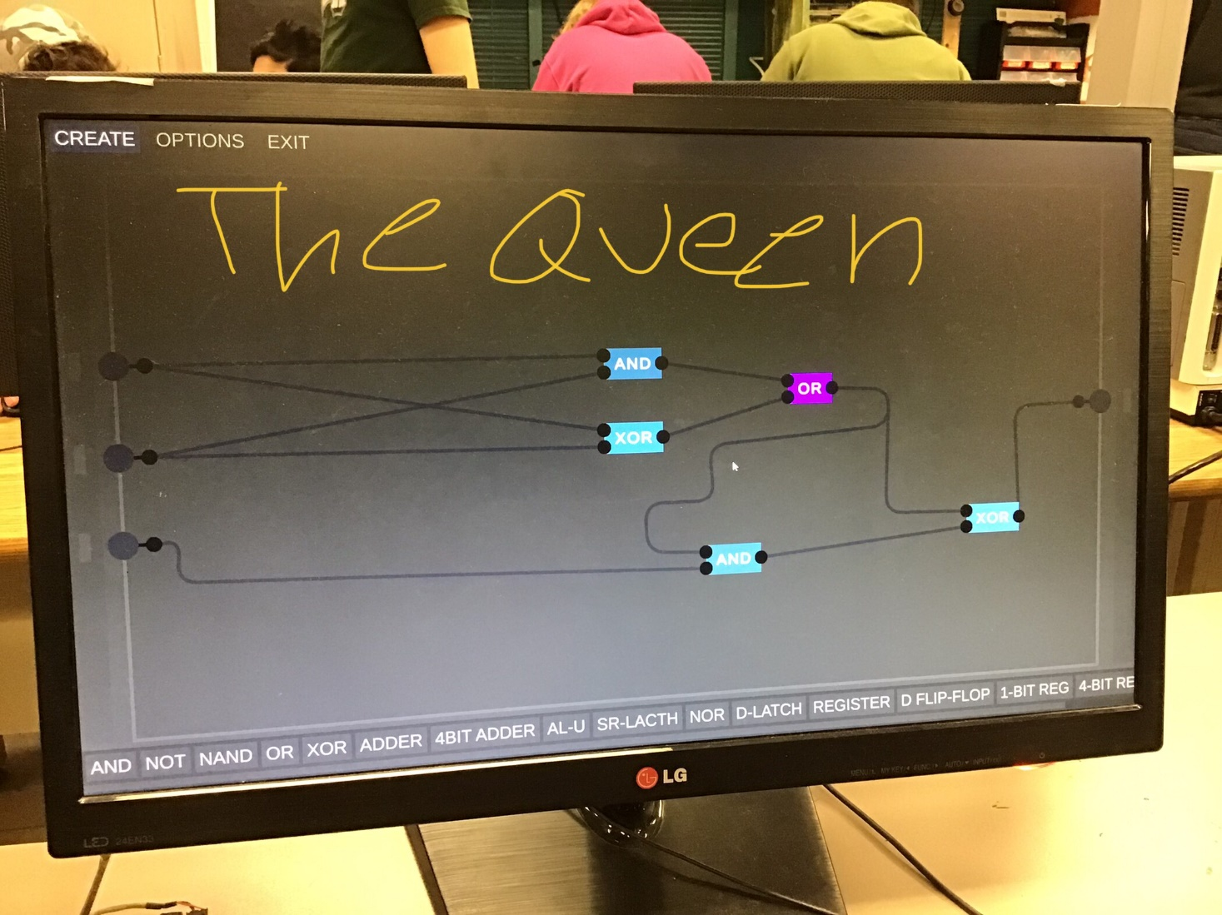
The Queen

Slide 6
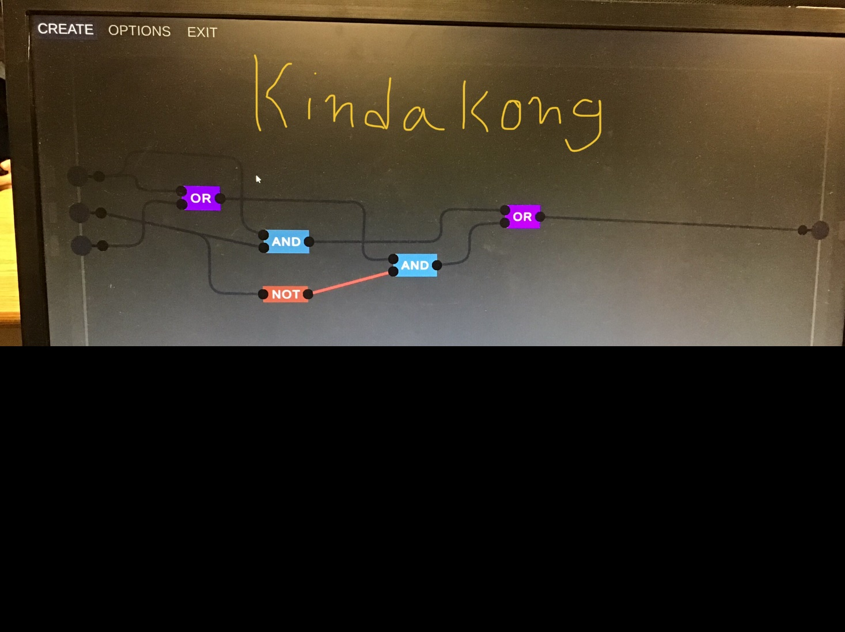
The Kindakong

